Slide 1
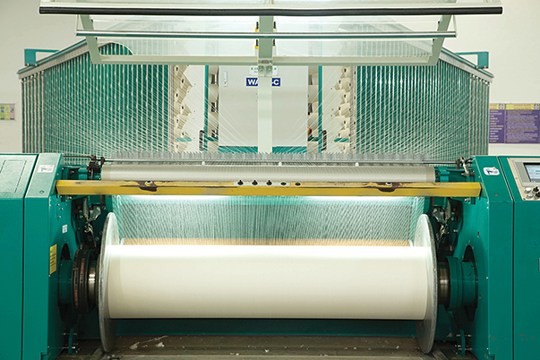
Fashion and Textile Professionals Visit to India

Slide 2
The Giles Brooker Group, in collaboration with Islamic Fashion Institute, Bandung, is facilitating a 7 day visit to South India for Indonesian textile and fashion professionals
to explore business opportunities with the fashion, textile and apparel industry in India.

Slide 3
Programme details:
Duration: 7 days
Programme confirmation: 45 days before departure
Minimum numbers: 10 participants
Investment: US$ 620 approximately
Indicative dates: 21st to 28th Nov 2019
Cost Includes: Programme cost, Boarding and Lodging, Local transportation & Sightseeing excursions.
Excludes: International travel, Visas, Insurance & Service on special requests

Slide 4
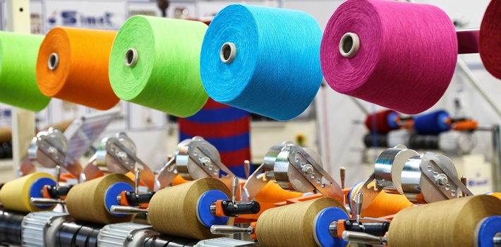
Objectives
To explore the Indian textile and apparel industry and related technologies.
To identify and explore International business opportunities.

Slide 5
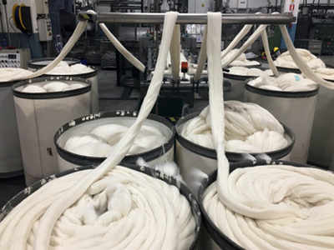
The Textile, Apparel and Fashion Industry in Southern India
The Indian Textile, Apparel and Fashion industry is one of the largest in the world with a large raw material base and manufacturing strength across the value chain.

Slide 6
The Textile, Apparel and Fashion Industry in Southern India
India is admired for its cotton textiles since ancient times and continues to be a flourishing textile centre to this day.
Southern India has a vast textile wealth and abundant weaving regions applying traditional weaving techniques that have continued to flourish even after centuries have passed.

Slide 7
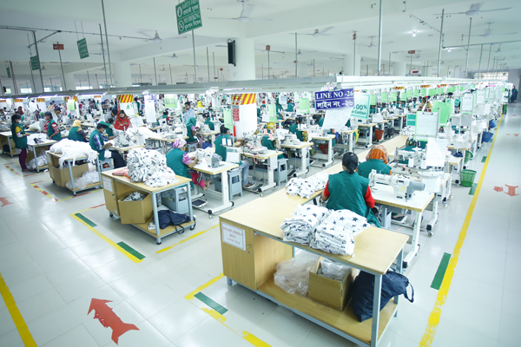
The Textile, Apparel and Fashion Industry in Southern India
The tropical southern states of Kerala, Tamil Nadu, Karnataka and Andhra Pradesh, have always had their distinctive cultural features which have contributed to an almost unlimited range of materials to be found and a great variety of weaving and production techniques.

Slide 8
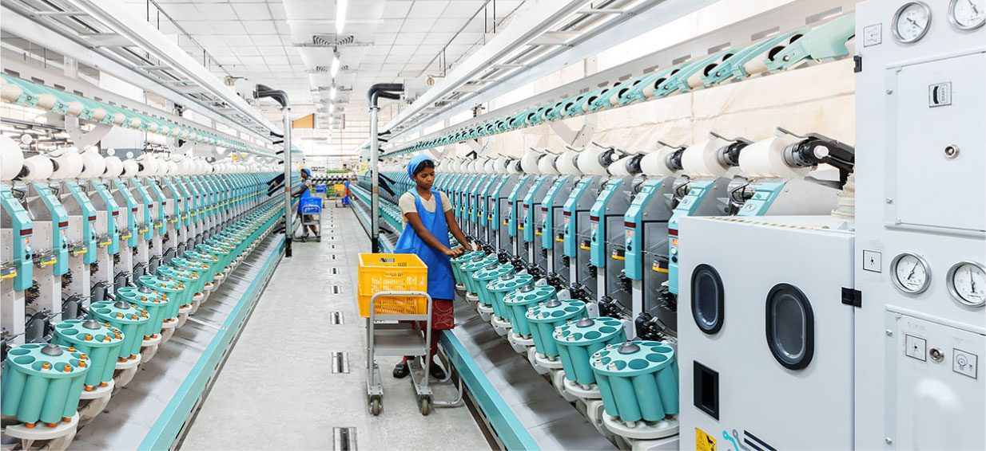
The Textile, Apparel and Fashion Industry in Southern India
The industry is one of the largest contributors to the Indian economy.

Slide 9
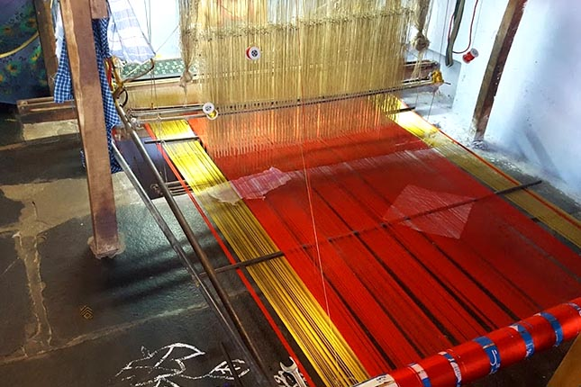
Silk in India
Tamil Nadu has the highest number of handloom weavers in India and is home to many hand woven garments – both in silk and cotton.

Slide 10
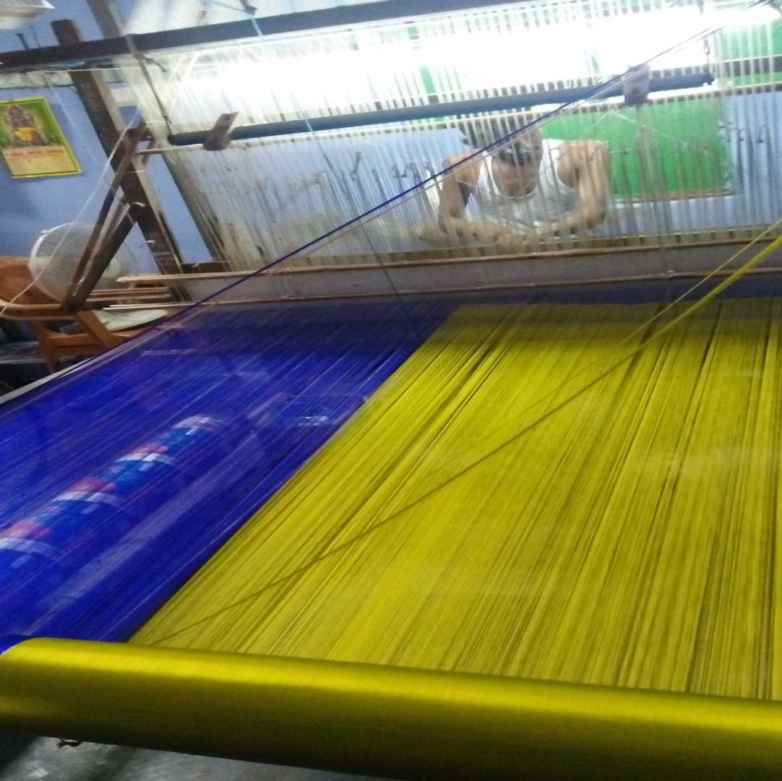
Silk in India
Handloom industry is the traditional industry in Tamilnadu providing employment to more than 10 lakh persons.
There are a number of villages wherein the handloom sector tends to concentrate.

Slide 11
Reasons for visit
The Programme covers the following areas:
Introduction to Indian Textile and Apparel Technology.
Visits to Traditional Handloom, Mass Production Units, wholesale markets and retail outlet.

Slide 12
Reasons for visit
Interactions with industry experts, designers, suppliers and buyers to explore business opportunities.
Exposure to the cultural context for Indian textiles and fashion.

Slide 13
AV of Preview about a collaboration of Indian Silk and New Zealand Fashion
https://drive.google.com/open?id=11nFi59Ance4eQJxmbGy0vf3Yuj62mF-p

Slide 14
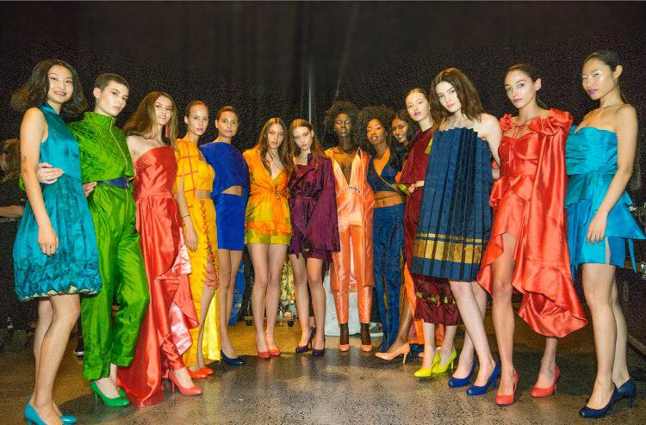
Silk from India showcased in New Zealand
It takes a village to weave sarees for fashion project

Slide 15
Silk from India showcased in New Zealand
The silk sarees for the project were created by families of weavers working with looms in their homes in a southern Indian saree village called Doddampalayam, just outside of Sathyamangalam 70kms from the city of Coimbatore.

Slide 16
Silk from India showcased in New Zealand
Once showcased in New Zealand – at New Zealand Fashion Week, in magazines and on websites – patterns are taken to India by the NZ Fashion Tech students who had won the New Zealand Prime Minister’s Scholarships for Asia.

Slide 19
Kiwi fashion students in India
From 2014, every year a batch of students have been visiting from New Zealand to India to explore Indian textile, Apparel and Fashion.
All of the Kiwi fashion students also get dressed head-to-toe in traditional Indian fashion. The girls wear saris and the boys wear dhoti.
Their experience has been described as “Six weeks of awesome" and they wanted to give back by dressing the Indian way.

Slide 20
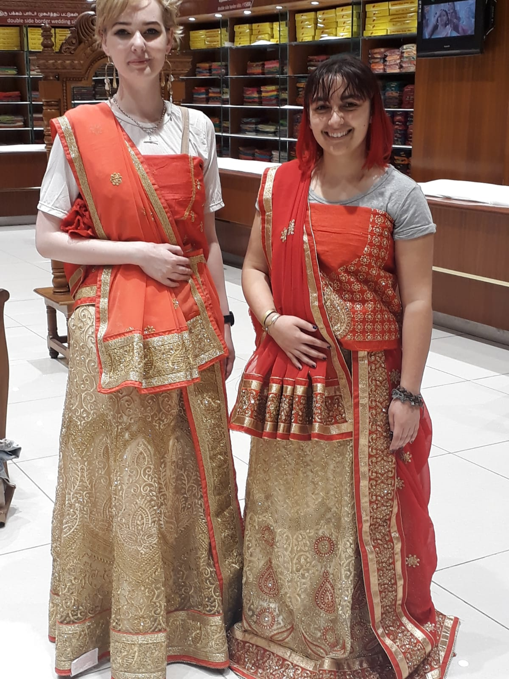
Some Glimpzz - Kiwi fashion students in India

Slide 21
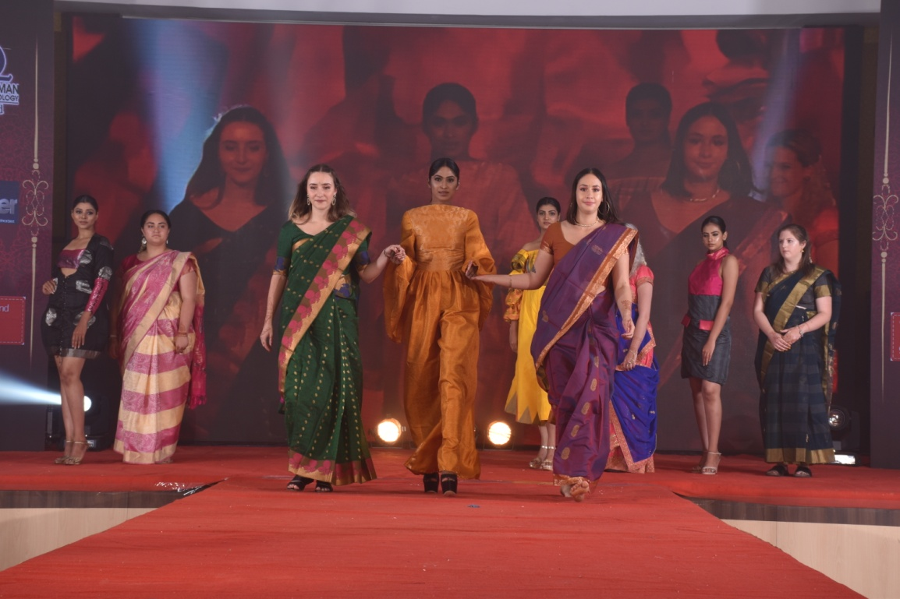
Some more Glimpzz - Kiwi fashion students in India

Slide 22
New Zealand fashion students show-cased their design in India
https://drive.google.com/open?id=16WIKN9MnnFPfZomo4X4YPpvqVg97BgmH

Slide 23
Tex Valley – A textile Market
It is one of a kind textile market in South India where we find the products and suppliers directly.
Texvalley, with some of the finest collections of textiles, apparel, made ups and home furnishing items, offers a huge opportunity for wholesalers and large retailers to source the best of products at extremely competitive rates from one single place.
It has an iconic daily market shopping area, which has set a new benchmark in size, aesthetics, features, design and facilities in the B2B space.

Slide 24
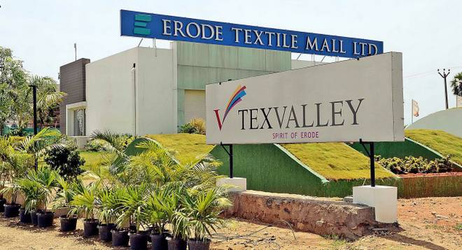
Tex Valley – A textile Market
Texvalley, is not just a shopping or trading place, it is a whole new sourcing experience.

Slide 25
Weaves – A textile and fashion event
WEAVES, a premier textile fair, will be held at Texvalley, Erode, Tamil Nadu, India in November 2019.
The event will highlight different kind of fabrics like greige, handlooms/khadi, finished and processed fabrics, ethnic wear and apparel fabrics as well as home textiles.

Slide 26
Glimpses of Weaves 2018 | Texvalley
https://youtu.be/Jo8xdnrmDxc

Slide 27
Glimpses of Weaves 2018 | Texvalley Fashion show – Giles Brooker group and Nz design
https://www.youtube.com/watch?v=VmnKJi9-Ehs&feature=youtu.be

Slide 28
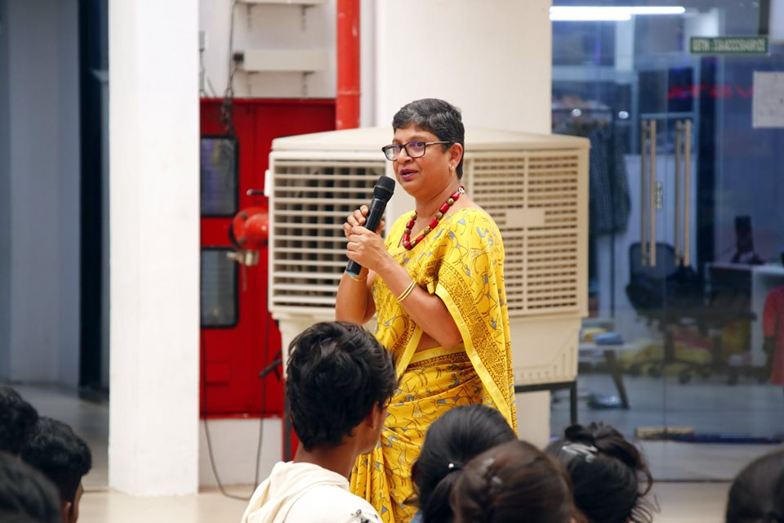
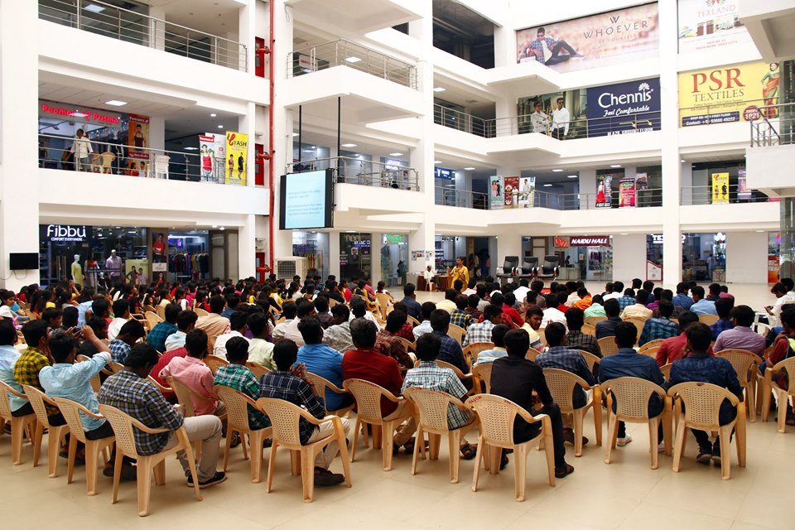
Giles Brooker Group Introducing International fashion in india !!!!

Slide 29
For more details, contact
Ms. Prabha Govindasamy
Giles Brooker Group
Mobile/ Whatsapp: +64 210 402 346
Email: office@gilesbrooker.com
Website: www.gbeducation.in

Slide 30
Thank you

